Slide 1
Lesson 3
Notes:
13:00–13:15 recap of Lesson 2 13:15–14:00 why cluster sequences + what clustering means 14:00–14:45 hierarchical clustering + choosing number of clusters 14:45–15:00 break 15:00–15:25 interpreting and labelling clusters 15:25–16:40 R lab: clustering, plots, cluster summaries 16:40–17:00 interpretation exercise + mini-project preparation

Slide 2
Identifying trajectory types

Slide 3
Identifying trajectory types
Trajectory types
Notes:
From hundreds of individual histories to a small number of interpretable trajectory patterns.
Clustering is a way to summarise complexity, not to erase it.

Slide 4
Where we are
build → describe → compare → cluster → interpret
Lesson 1: build and describe
Lesson 2: distances and OM
Lesson 3: clustering and typologies
Lesson 4: interpretation, mini-projects, presentations

Slide 5
Recap: what did distances do for us?
Anna
Ben
Distance matrix:
Distances quantify how different two trajectories are.
Small distance = similar trajectories.
Large distance = dissimilar trajectories.
A distance matrix compares every sequence to every other sequence.
 | Anna | Ben
Anna | 0 | 2
Ben | 2 | 0
Today, we use this matrix to build groups.

Slide 6
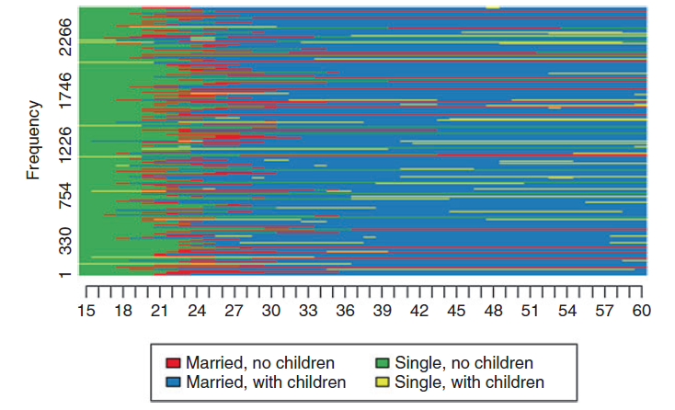
Today’s question: can we summarise many trajectories into meaningful groups?
Fig.3 Index plot of women’s family history (N = 2547). From Vanhoutte et al. (2018)
Notes:
Could we describe every individual trajectory one by one?
Usually no. We need a smaller vocabulary of trajectory types.
Example of groups:
Early partnership and parenthood
Stable family life
Less stable family life and several transitions in and out of partnerships
Stable in singlehood and childlessness, etc.

Slide 7
Why clustering? Reducing complexity without erasing trajectories
Individual biographies → groups/categories → easier comparison
Before clustering
Many trajectories, difficult to summarise.
After clustering
A smaller number of trajectory types.
Risk
Some individual detail is lost.
Notes:
The goal is simplification with interpretation.

Slide 8
A simple example: four work trajectories
Employed
Unemployed
Studies
A
B
C
D
Stable employment
Delayed employment entry
Early unemployment, then employment
Unstable employment
Notes:
Which ones feel close? Which ones feel different?

Slide 9
What clustering means

Slide 10
Clustering is a summary, not a discovery of “true groups”
Typology ≠ Reality
Clusters are produced by analytical choices.
They depend on the distance measure.
They depend on the clustering algorithm.
They depend on the chosen number of groups.
Studer’s WeightedCluster manual explicitly presents typologies as descriptive tools that bring out recurrent patterns, while warning against treating them as confirmatory proof (Studer, 2013)

Slide 11
Within-cluster similarity and between-cluster difference
Good clustering = high similarity within groups + high difference between groups
Within-cluster: people in the same group should be close.
Between-cluster: people in different groups should be far apart.

Slide 12
From distance matrix to clustering
Distance matrix
Clustering algorithm
Cluster membership
Cluster plots and interpretation
Example
 | Anna | Ben | Clara | Daniel
Anna | 0 | 2 | 5 | 4
Ben | 2 | 0 | 4 | 3
Clara | 5 | 4 | 0 | 1
Daniel | 4 | 3 | 1 | 0
Person | Cluster
Anna | 1
Ben | 2
Clara | 3
Daniel | 3
Clustering transforms a distance matrix into a categorical variable.

Slide 13
What information is lost when we cluster?
Individual sequence ribbons inside one cluster, not all identical.
When we assign people to one cluster, we may lose:
Small timing differences
Rare transitions
Heterogeneity within the group
Uncertainty of assignment
Unusual cases
Notes:
A cluster label is a simplification, not a full description.

Slide 14
When clustering is useful and when it is not
Useful when… | Less useful when…
Many trajectories are hard to summarise | Sample is very small
You need interpretable trajectory types | No clear recurrent patterns exist
You want to compare groups | The research question concerns one specific transition
You need a categorical exposure/outcome | Clusters would hide important variation
Not every sequence analysis needs clustering.

Slide 15
Hierarchical clustering

Slide 16
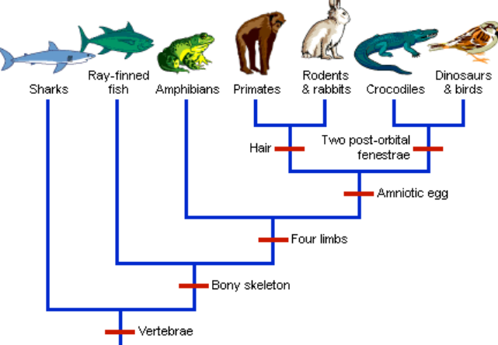
The basic logic of hierarchical clustering
Family tree
Hierarchical clustering builds a tree of similarity.
Process:
Start with each person alone.
Merge the closest cases.
Continue merging until everyone is in one group.
Then choose where to cut the tree.
Source: Institute of Canine Biology

Slide 17
Agglomerative clustering: from individuals to groups
A
B
C
D
E
Notes:
Agglomerative = bottom-up clustering.

Slide 18
Dendrograms: reading the tree
HIGH-MERGE
More different cases
LOW-MERGE
Very similar cases
LEAVES
A
B
C
D
E
Notes:
Cutting the tree at different heights gives different numbers of clusters.
Where would you cut this tree: 2, 3 or 4 groups?

Slide 19
Linkage methods: Ward, average, complete
Method | Intuition behind it
Single | Merge groups with closest members
Complete | Merge based on most distant members
Average | Merge based on average distance
Ward | Merge to minimise within-group variance/discrepancy
The same distance matrix can produce different clusters depending on linkage method.
Notes:
Linkage methods decide how distance between groups is calculated after individuals have already been merged. Example: if cluster A has 3 people and cluster B has 3 people, do we compare the closest pair, the farthest pair, the average distance, or the increase in within-cluster variation? That is what linkage means.

Slide 20
Why Ward is often used in sequence analysis
Ward tries to create compact clusters.
It is not automatically the best method: Ward can be sensitive to atypical cases and should be checked against plots, cluster sizes and alternative solutions.
It merges groups when doing so it adds the smallest possible amount of within-cluster heterogeneity.
It often gives readable typologies in sequence analysis.
It is commonly used as a default starting point in sequence-analysis typologies.

Slide 21
Clustering choices are connected to distance choices
Time axis
State alphabet
Distance measure
Cost settings
Clustering algorithm
Typology
For example:
Hamming distance may create early/late timing groups.
Low-indel OM may group delayed but similar trajectories together.
Different distances can lead to different clusters.
Notes:
The final typology is the end of a chain of decisions.

Slide 22
Choosing the number of clusters

Slide 23
The difficult question: how many clusters?
Same sequences can be cut into 2, 3, 4, 6 groups…
There is rarely one obviously correct number.
Three criteria:
Statistical quality
Substantive meaning
Usefulness for the research question.

Slide 24
Statistical criteria: ASW, CH, Hubert’s Gamma
Criterion | Intuition | We want the value to be
Average Silhouette Width (ASW) | Are people well assigned to their cluster? | Higher
Calinski-Harabasz index (CH) | Ratio of between/within cluster separation | Higher
Hubert’s Gamma | Does the partition reproduce the distance matrix? | Higher
Hubert’s C | Gap from best possible partition | Lower
Notes:
ASW evaluates coherence of assignments; CH is a pseudo-F statistic; Hubert’s Gamma assesses how well the partition reproduces the distance matrix.
ASW, CH or Hubert’s Gamma can help us compare solutions, but they do not choose for us. They answer questions like: are cases close to their own cluster? Are clusters separated? Does the partition reflect the distance matrix? But a statistically good solution can still be substantively useless if the clusters cannot be interpreted.

Slide 25
Substantive criteria: interpretability and usefulness
Can I explain each of these groups in one sentence?
Can I describe each cluster clearly?
Are clusters distinct enough?
Do labels reflect real trajectory differences?
Are clusters large enough to analyse?
Does the typology help answer the research question?
Notes:
A statistically neat typology is not useful if nobody can interpret it.

Slide 26
Too few clusters: important differences disappear
Example: 2-cluster solution
Mostly stable
employment
Problem: Too few clusters can over-smooth the life course and can hide major differences
Mostly unstable
employment
Notes:
Early entry and late entry may be merged
Interruptions (care) may disappear
Upward and downward trajectories may be hidden.

Slide 27
Too many clusters: typology becomes unreadable
9-cluster solution
Stable employment
Almost stable employment
.
Problem: Too many clusters can turn description into noise
Delayed entry then stable
One unemployment spell
2+ unemployment spells
Unstable employment
One care-related interruption
2+ care-related interruptions
Notes:
Problem:
clusters become tiny;
labels become arbitrary;
interpretation becomes unstable;
statistical models may become underpowered.

Slide 28
Comparing 3-, 4-, 5- and 6-cluster solutions
Idea:
Define three clusters and generate their index plot.
Define four clusters and generate their index plot.
Same for 5 and 6. What are the changes you observe?
Solution | What to inspect
3 clusters | What broad patterns appear?
4 clusters | Which group splits? Is the split meaningful?
5 clusters | Does it add nuance? Is it helpful?
6 clusters | Are we adding information or just detail?

Slide 29
A good typology is both statistical and meaningful
Things to care about
Good enough quality indicators
Interpretable cluster plots
Reasonable cluster sizes
Robust to plausible alternatives
Useful for the research question.
Statistical quality
Sustantive interpretation
Notes:
The best solution is not simply the one with the highest number in a table.

Slide 30
Interpreting and labelling clusters

Slide 31
What makes a cluster interpretable?
Dominant states
Timing of transitions
Duration in states
Instability or continuity
How it differs from other clusters
A cluster is interpretable when we can describe:
Example: for « unstable employment » cluster, observe three types of summaries:
Index plot:
« Individual trajectories inside the cluster: many switches between employment and unemployment. »
State distribution plot:
« At each age/month, the share in employment vs unemployment changes often »
Numerical summary box
Mean years unemployed: high
Mean transitions: high
Dominant feature: repeated interruption
Notes:
Typical sentence: « This cluster contains people who mostly -------, with transitions occurring around ----------. »

Slide 32
Typical sequences and representative sequences
In one cluster:
A representative sequence is an observed or selected sequence that summarises a group.
It helps avoid relying only on abstract cluster labels.
It shows what “typical” looks like within the cluster.
E.g. in the cluster Stable employment:
Stable employment all along
Stable employment after studies
Stable employment with one care-related interruption

Slide 33
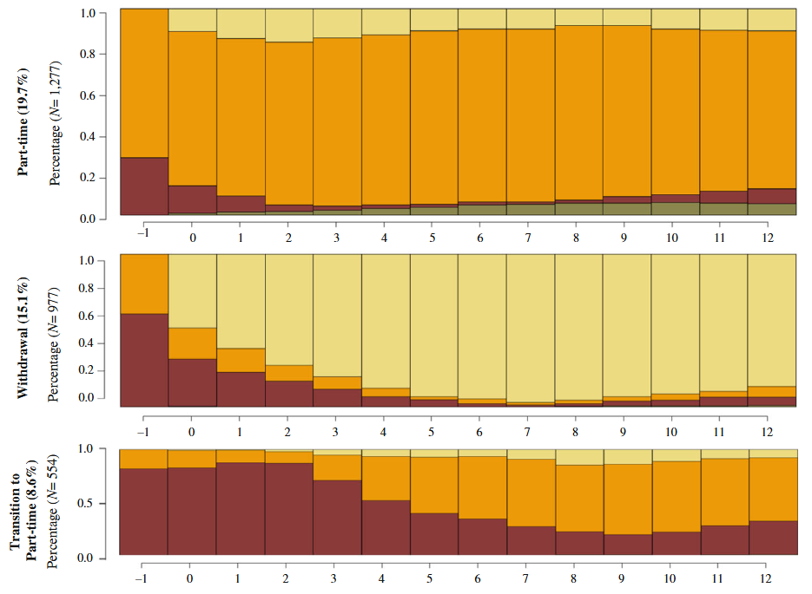
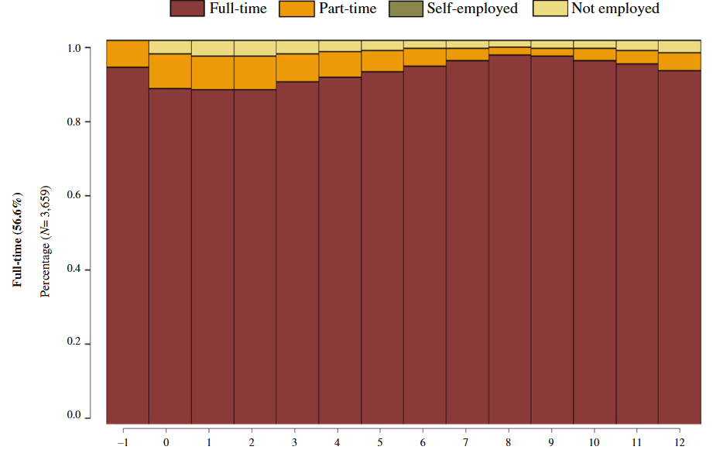
State distribution plot by cluster
From Lu et al, 2017
Fig xx. State distribution plot by employment trajectory clusters, women,months relative to childbirth, SIPP 1996–2013
Notes:
Use these plots to see:
dominant state at each time point;
timing of transitions;
how group composition changes over time;
differences between clusters.

Slide 34
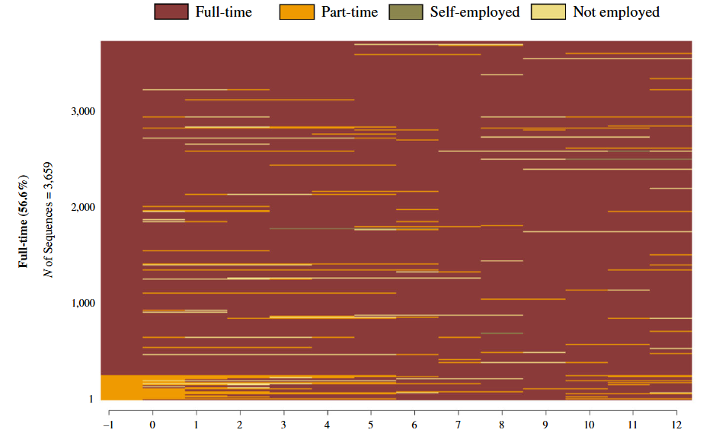
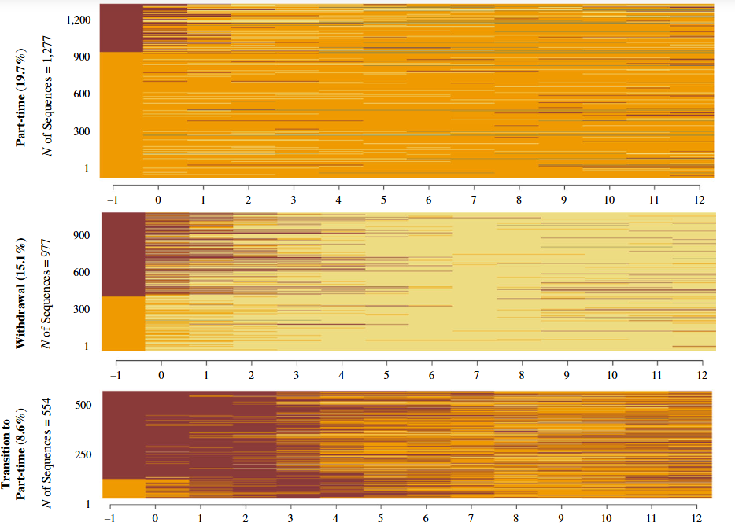
Index plots by cluster
From Lu et al, 2017
Sequence index plot of employment trajectory clusters, women, months relative to childbirth, SIPP 1996–2013
Notes:
Use index plots to see:
heterogeneity inside clusters;
whether cases are really similar;
outliers or poorly assigned cases;
internal timing differences.

Slide 35
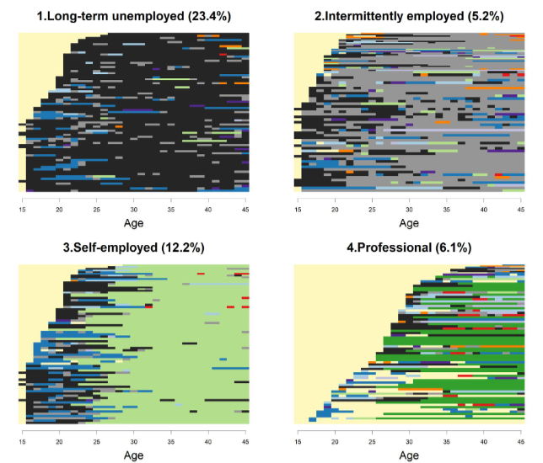
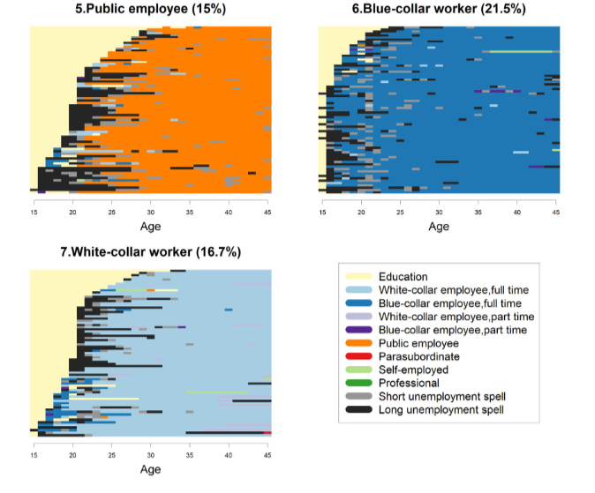
Index plots by cluster (2)
From Devillanova et al, 2018
Fig. Xx Clusters of employment trajectories from age 15 to age 45
Notes:
Use these plots to see:
dominant state at each time point;
timing of transitions;
how group composition changes over time;
differences between clusters.

Slide 36
Cluster summaries: time in states, transitions, complexity
Example:
Cluster | Main state | Mean time in unemployment | Mean transitions | Interpretation
1 | Employment | Low | Low | Stable employment
2 | Education → employment | Low | Medium | Delayed entry
3 | Unemployment | High | Medium | Difficult transition
4 | Mixed | Medium | High | Instability
Notes:
Good interpretation combines plots and numbers.
TraMineR supports longitudinal characteristics, pairwise dissimilarities and multiple visualisations for state sequences.

Slide 37
How to name clusters without claiming too much
Bad labels:
“successful”
“failed”
“problematic”
“normal”
“deviant”
Better labels:
“stable employment”
“delayed employment entry”
“repeated unemployment”
“early family-care interruption”
“late transition to employment”
Notes:
Label what the trajectory shows, not what you assume it means.

Slide 38
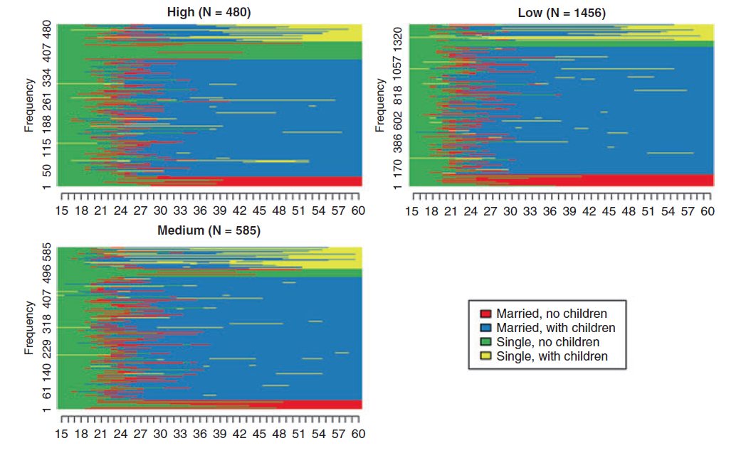
Checking cluster composition: covariates and group differences
From Vanhoutte et al, 2018
After labelling clusters:
Who is overrepresented in each cluster?
Do clusters differ by cohort, gender, education or origin?
Are differences descriptive or part of a later model?
Notes:
Do not use covariates to “prove” that clusters are real. Use them to understand who follows which trajectory.

Slide 39
Reporting typologies transparently
Report checklist
population and observation window;
time axis and unit;
state alphabet;
distance measure and costs;
clustering method;
criteria used to choose number of clusters;
plots used to interpret clusters;
final cluster sizes;
sensitivity checks;
limits of interpretation.
Notes:
A typology is credible when readers can understand how it was built.

Slide 40
references
Devillanova, C., Raitano, M., & Struffolino, E. (2019). Longitudinal employment trajectories and health in middle life. Demographic Research, 40, 1375-1412.
Lu, Y., Wang, J. S. H., & Han, W. J. (2017). Women’s short-term employment trajectories following birth: Patterns, determinants, and variations by race/ethnicity and nativity. Demography, 54(1), 93-118.

Slide 41
Lab and transition to Lesson 4

Slide 42
Today’s lab mission
By the end of the lab, you will:
Load the distance matrix from lesson 2
Run hierarchical clustering
Compare 3-6 cluster solutions
Calculate cluster-quality indicators (ASW, CH, Hubert’s Gamma)
Plot clusters
Summarise and label one preferred typology
Prepare figures for the mini-project

Slide 43
New concepts (you can discuss in pairs)
Now, you should be able to explain or define:
What does the linkage method decide?
Why is Ward often used?
What is a dendrogram?
What does cutree() do?
What does ASW measure?
What does CH measure?
What does Hubert’s Gamma measure?
Why can the indicators disagree?
Why is a cluster label a simplification?
What changes when we move from 3 to 4 clusters? Is the new distinction substantively useful?

Slide 44
Mini-project
Today you work on Section 3.3 and Section 4.2 of your report
Clustering method
Cluster-number justification
Main trajectory typology result
Step 1: Cluster your main distance matrix
Use hierarchical clustering, usually Ward as a starting point.
Step 2: Compare several values of k
Suggested range: 3–6 clusters.
Step 3: Evaluate
Use: cluster sizes, ASW, CH and Hubert’s Gamma, state distribution plots, index plots, representative sequences
Step 4: Choose your preferred solution
Write a justification that combines statistical and substantive criteria.
Before leaving today, write down:
My clustering method is...
I compared k = ...
The statistical criteria suggested...
I selected k = ...
I selected it because...
My cluster labels are...

Slide 45
Mini-project checkpoint: what typology might you use?
Fill in this text:
My sequence domain:
My time axis:
My states:
My distance measure:
Possible number of clusters:
What each cluster might represent:
One concern:
Notes:
“What would make a cluster solution useful for your own research question?”

Slide 46
Preview of Lesson 4: Linking trajectories to outcomes
Next time:
use clusters in descriptive comparisons;
use clusters in regression;
distinguish determinants from outcomes;
avoid post-treatment bias;
prepare student presentations.

Slide 47
Next session: 5-minute presentation
Objective:
To help you prepare the short report
To organise your thoughts
For next week, prepare slides 1-3
Research question and data
Sequence construction and method
Main trajectory figure
Slide 4 will be optional and done next week. You can already think of:
Some preliminary interpretation (to be confirmed with Lab 4 results)
One methodological limitation
Perhaps your cluster-solution sensitivity result from Session 3.
Notes:
By the end of Session 3 they should already have:
research question
population, states, time axis/unit
descriptive sequence figure
distance measure and justificatin
preferred cluster solution
cluster labels
main typology figure.

Slide 48
Extra slides

Slide 49
On R: distance matrix → clustering → cluster variable
library(TraMineR)
library(WeightedCluster)
# distance matrix from Lesson 2
# dist_om <- seqdist(mvad.seq, method = "OM", indel = 1, sm = "CONSTANT")
clust_tree <- hclust(as.dist(dist_om), method = "ward.D2")
cluster4 <- cutree(clust_tree, k = 4)
table(cluster4)
Notes:
Explanation:
hclust() builds the tree.
cutree() chooses the number of clusters.
cluster4 becomes a categorical variable.
WeightedCluster gives examples of using hierarchical clustering with a distance matrix and then visualising/assessing solutions.

Slide 50
On R: visualise cluster solutions
seqdplot(mvad.seq, group = cluster4, main = "State distribution by cluster")
seqIplot(mvad.seq, group = cluster4, sortv = "from.start", main = "Index plot by cluster")
To interpret:
What state dominates each cluster?
When do transitions occur?
How homogeneous is the cluster?
Are some clusters hard to describe?
Notes:
TraMineR’s seqplot family includes state distribution plots, index plots, modal state plots, mean time plots and representative sequence plots.

Slide 51
On R: compare cluster summaries
cluster_quality <- wcClusterQuality(as.dist(dist_om), cluster4)
cluster_quality$stats
Additional summaries
seqmeant(mvad.seq, group = cluster4)
seqtransn(mvad.seq)
seqici(mvad.seq)
Notes:
Explanation:
Quality indicators help compare solutions.
They do not decide automatically.
Use them with plots and interpretation.

